Slide 1
Recommender System Design
madhusudhanan.b@wilp.bits-pilani.ac.in
https://www.linkedin.com/in/drmadhub/
Thanks to content adopted from Prof.Dietmar’s book

Slide 2
Recommender Systems

Slide 3
Recommender Systems

Slide 4

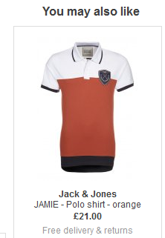
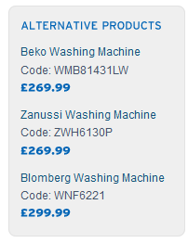
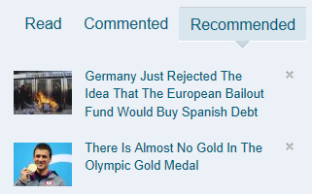
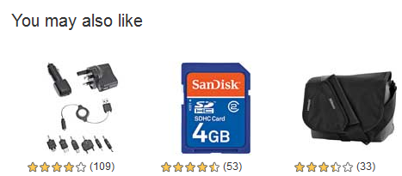
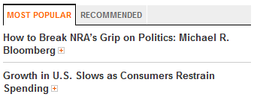
Recommender Systems
Application areas

Slide 5
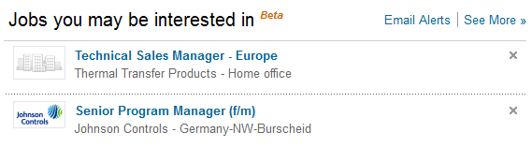
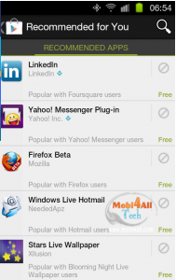
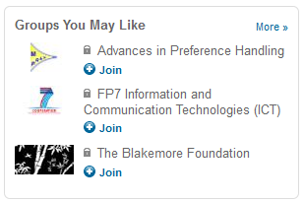
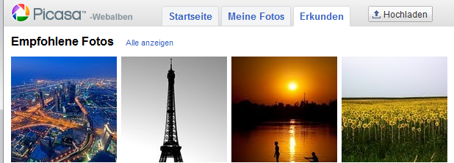
In the Social Web

Slide 6
Why using Recommender Systems?
Value for the customer
Find things that are interesting
Narrow down the set of choices
Help me explore the space of options
Discover new things
Entertainment
…
Value for the provider
Additional and probably unique personalized service for the customer
Increase trust and customer loyalty
Increase sales, click trough rates, conversion etc.
Opportunities for promotion, persuasion
Obtain more knowledge about customers
…

Slide 8
Problem domain
Recommendation systems (RS) help to match users with items
Ease information overload
Sales assistance (guidance, advisory, persuasion,…)
RS are software agents that elicit the interests and preferences of individual consumers […] and make recommendations accordingly.
They have the potential to support and improve the quality of the decisions consumers make while searching for and selecting products online.
[Xiao & Benbasat, MISQ, 2007]
Different system designs / paradigms
Based on availability of exploitable data
Implicit and explicit user feedback
Domain characteristics

Slide 9
Recommender systems
RS seen as a function [AT05]
Given:
User model (e.g. ratings, preferences, demographics, situational context)
Items (with or without description of item characteristics)
Find:
Relevance score. Used for ranking.
Finally:
Recommend items that are assumed to be relevant
But:
Remember that relevance might be context-dependent
Characteristics of the list itself might be important (diversity)

Slide 10
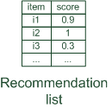

Paradigms of recommender systems
Recommender systems reduce information overload by estimating relevance

Slide 11


Paradigms of recommender systems
Personalized recommendations

Slide 12

Paradigms of recommender systems
Collaborative: "Tell me what's popular among my peers"

Slide 13

Paradigms of recommender systems
Content-based: "Show me more of the same what I've liked"

Slide 14


Paradigms of recommender systems
Knowledge-based: "Tell me what fits based on my needs"

Slide 15
Paradigms of recommender systems
Hybrid: combinations of various inputs and/or composition of different mechanism

Slide 16


Recommender systems: basic techniques
 | Pros | Cons
Collaborative | No knowledge-engineering effort, serendipity of results, learns market segments | Requires some form of rating feedback, cold start for new users and new items
Content-based | No community required, comparison between items possible | Content descriptions necessary, cold start for new users, no surprises
Knowledge-based | Deterministic recommendations, assured quality, no cold-start, can resemble sales dialogue | Knowledge engineering effort to bootstrap, basically static, does not react to short-term trends

Slide 17
Collaborative Filtering (CF)
The most prominent approach to generate recommendations
used by large, commercial e-commerce sites
well-understood, various algorithms and variations exist
applicable in many domains (book, movies, DVDs, ..)
Approach
use the "wisdom of the crowd" to recommend items
Basic assumption and idea
Users give ratings to catalog items (implicitly or explicitly)
Customers who had similar tastes in the past, will have similar tastes in the future

Slide 18
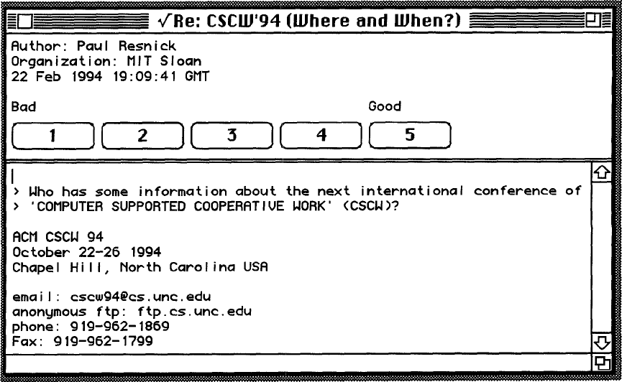
1994: GroupLens: an open architecture for collaborative filtering of netnews, P. Resnick et al., ACM CSCW
Tapestry system does not aggregate ratings and requires knowing each other
Basic idea: "People who agreed in their subjective evaluations in the past are likely to agree again in the future"
Builds on newsgroup browsers with rating functionality

Slide 19
User-based nearest-neighbor collaborative filtering (1)
The basic technique:
Given an "active user" (Alice) and an item I not yet seen by Alice
The goal is to estimate Alice's rating for this item, e.g., by
find a set of users (peers) who liked the same items as Alice in the past and who have rated item I
use, e.g. the average of their ratings to predict, if Alice will like item I
do this for all items Alice has not seen and recommend the best-rated
 | Item1 | Item2 | Item3 | Item4 | Item5
Alice | 5 | 3 | 4 | 4 | ?
User1 | 3 | 1 | 2 | 3 | 3
User2 | 4 | 3 | 4 | 3 | 5
User3 | 3 | 3 | 1 | 5 | 4
User4 | 1 | 5 | 5 | 2 | 1

Slide 20
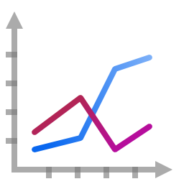
User-based nearest-neighbor collaborative filtering (2)
Some first questions
How do we measure similarity?
How many neighbors should we consider?
How do we generate a prediction from the neighbors' ratings?
 | Item1 | Item2 | Item3 | Item4 | Item5
Alice | 5 | 3 | 4 | 4 | ?
User1 | 3 | 1 | 2 | 3 | 3
User2 | 4 | 3 | 4 | 3 | 5
User3 | 3 | 3 | 1 | 5 | 4
User4 | 1 | 5 | 5 | 2 | 1

Slide 21


Measuring user similarity
A popular similarity measure in user-based CF: Pearson correlation
a, b : users
r_{a,p} : rating of user a for item p
P : set of items, rated both by a and b
Possible similarity values between -1 and 1; = user's average ratings
$\overline{r_{a}}$, $\overline{r_{b}}$
 | Item1 | Item2 | Item3 | Item4 | Item5
Alice | 5 | 3 | 4 | 4 | ?
User1 | 3 | 1 | 2 | 3 | 3
User2 | 4 | 3 | 4 | 3 | 5
User3 | 3 | 3 | 1 | 5 | 4
User4 | 1 | 5 | 5 | 2 | 1
sim = 0,85
sim = 0,70
sim = -0,79

Slide 22
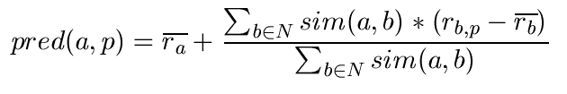
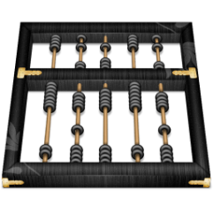
Making predictions
A common prediction function:
Calculate, whether the neighbors' ratings for the unseen item i are higher or lower than their average
Combine the rating differences – use the similarity as a weight
Add/subtract the neighbors' bias from the active user's average and use this as a prediction

Slide 23
Making recommendations
Making predictions is typically not the ultimate goal
Usual approach
Rank items based on their predicted ratings
However
This might lead to the inclusion of (only) niche items
In practice also: Take item popularity into account
Approaches
"Learning to rank"
Optimize according to a given rank evaluation metric (see later)

Slide 24
Improving the metrics / prediction function
Not all neighbor ratings might be equally "valuable"
Agreement on commonly liked items is not so informative as agreement on controversial items
Possible solution: Give more weight to items that have a higher variance
Value of number of co-rated items
Use "significance weighting", by e.g., linearly reducing the weight when the number of co-rated items is low
Case amplification
Intuition: Give more weight to "very similar" neighbors, i.e., where the similarity value is close to 1.
Neighborhood selection
Use similarity threshold or fixed number of neighbors

Slide 25
Memory-based and model-based approaches
User-based CF is said to be "memory-based"
the rating matrix is directly used to find neighbors / make predictions
does not scale for most real-world scenarios
large e-commerce sites have tens of millions of customers and millions of items
Model-based approaches
based on an offline pre-processing or "model-learning" phase
at run-time, only the learned model is used to make predictions
models are updated / re-trained periodically
large variety of techniques used
model-building and updating can be computationally expensive

Slide 26
2001: Item-based collaborative filtering recommendation algorithms, B. Sarwar et al., WWW 2001
Scalability issues arise with U2U if many more users than items (m >> n , m = |users|, n = |items|)
e.g. Amazon.com
Space complexity O(m²) when pre-computed
Time complexity for computing Pearson O(m²n)
High sparsity leads to few common ratings between two users
Basic idea: "Item-based CF exploits relationships between items first, instead of relationships between users"

Slide 27
Item-based collaborative filtering
Basic idea:
Use the similarity between items (and not users) to make predictions
Example:
Look for items that are similar to Item5
Take Alice's ratings for these items to predict the rating for Item5
 | Item1 | Item2 | Item3 | Item4 | Item5
Alice | 5 | 3 | 4 | 4 | ?
User1 | 3 | 1 | 2 | 3 | 3
User2 | 4 | 3 | 4 | 3 | 5
User3 | 3 | 3 | 1 | 5 | 4
User4 | 1 | 5 | 5 | 2 | 1

Slide 28


The cosine similarity measure
Produces better results in item-to-item filtering
for some datasets, no consistent picture in literature
Ratings are seen as vector in n-dimensional space
Similarity is calculated based on the angle between the vectors
Adjusted cosine similarity
take average user ratings into account, transform the original ratings
U: set of users who have rated both items a and b

Slide 29
More on ratings
Pure CF-based systems only rely on the rating matrix
Explicit ratings
Most commonly used (1 to 5, 1 to 7 Likert response scales)
Research topics
"Optimal" granularity of scale; indication that 10-point scale is better accepted in movie domain
Multidimensional ratings (multiple ratings per movie)
Challenge
Users not always willing to rate many items; sparse rating matrices
How to stimulate users to rate more items?
Implicit ratings
clicks, page views, time spent on some page, demo downloads …
Can be used in addition to explicit ones; question of correctness of interpretation

Slide 30
2000: Application of Dimensionality Reduction in Recommender System, B. Sarwar et al., WebKDD Workshop
Basic idea: Trade more complex offline model building for faster online prediction generation
Singular Value Decomposition for dimensionality reduction of rating matrices
Captures important factors/aspects and their weights in the data
factors can be genre, actors but also non-understandable ones
Assumption that k dimensions capture the signals and filter out noise (K = 20 to 100)
Constant time to make recommendations
Approach also popular in IR (Latent Semantic Indexing), data compression, …

Slide 31
Association rule mining
Commonly used for shopping behavior analysis
aims at detection of rules such as
"If a customer purchases baby-food then he also buys diapers in 70% of the cases"
Association rule mining algorithms
can detect rules of the form X => Y (e.g., baby-food => diapers) from a set of sales transactions D = {t₁, t₂, … t_{n}}
measure of quality: support, confidence

Slide 32
Probabilistic methods
Basic idea (simplistic version for illustration):
given the user/item rating matrix
determine the probability that user Alice will like an item i
base the recommendation on such these probabilities
Calculation of rating probabilities based on Bayes Theorem
How probable is rating value "1" for Item5 given Alice's previous ratings?
Corresponds to conditional probability P(Item5=1 | X), where
X = Alice's previous ratings = (Item1 =1, Item2=3, Item3= … )
Can be estimated based on Bayes' Theorem
Usually more sophisticated methods used
Clustering
pLSA …

Slide 33
Collaborative Filtering Issues
Pros:
well-understood, works well in some domains, no knowledge engineering required
Cons:
requires user community, sparsity problems, no integration of other knowledge sources, no explanation of results
What is the best CF method?
In which situation and which domain? Inconsistent findings; always the same domains and data sets; differences between methods are often very small (1/100)
How to evaluate the prediction quality?
MAE / RMSE: What does an MAE of 0.7 actually mean?
Serendipity: Not yet fully understood
What about multi-dimensional ratings?

Slide 34

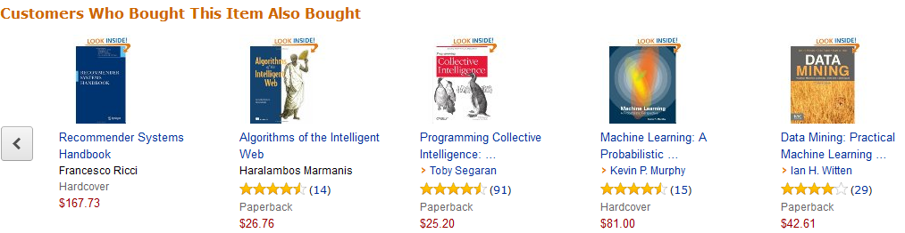
Recommender Systems in e-Commerce
One Recommender Systems research question
What should be in that list?

Slide 35
Recommender Systems in e-Commerce
Another question both in research and practice
How do we know that these are good recommendations?

Slide 36

Recommender Systems in e-Commerce
This might lead to …
What is a good recommendation?
What is a good recommendation strategy?
What is a good recommendation strategy for my business?
We hope you will buy also …
These have been in stock for quite a while now …

Slide 37
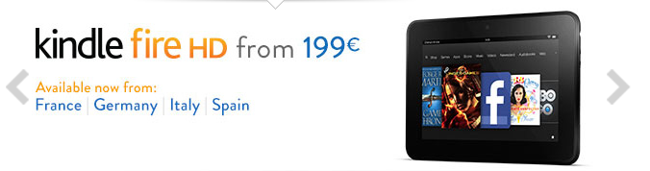

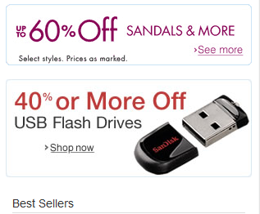
What is a good recommendation?
What are the measures in practice?
Total sales numbers
Promotion of certain items
…
Click-through-rates
Interactivity on platform
…
Customer return rates
Customer satisfaction and loyalty

Slide 38
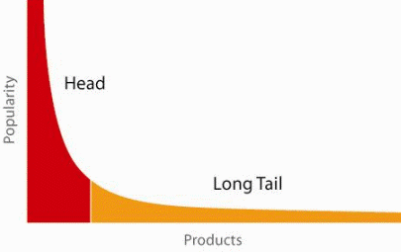
When does a RS do its job well?
"Recommend widely unknown items that users might actually like!"
20% of items accumulate 74% of all positive ratings
Recommend items from the long tail

Slide 39
Purpose and success criteria (2)
Prediction perspective
Predict to what degree users like an item
Most popular evaluation scenario in research
Interaction perspective
Give users a "good feeling"
Educate users about the product domain
Convince/persuade users - explain
Finally, conversion perspective
Commercial situations
Increase "hit", "clickthrough", "lookers to bookers" rates
Optimize sales margins and profit

Slide 40
Evaluation in information retrieval (IR)
Recommendation is viewed as information retrieval task:
Retrieve (recommend) all items which are predicted to be "good" or "relevant".
Common protocol :
Hide some items with known ground truth
Rank items or predict ratings -> Count -> Cross-validate
Ground truth established by human domain experts
 |  | Reality
 |  | Actually Good | Actually Bad
Prediction | Rated Good | True Positive (tp) | False Positive (fp)
 | Rated Bad | False Negative (fn) | True Negative (tn)

Slide 41
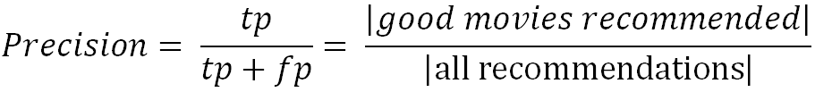
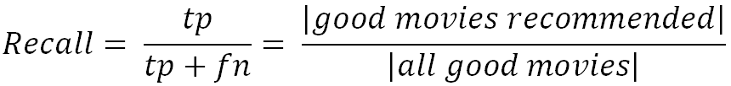
Metrics: Precision and Recall
Precision: a measure of exactness, determines the fraction of relevant items retrieved out of all items retrieved
E.g. the proportion of recommended movies that are actually good
Recall: a measure of completeness, determines the fraction of relevant items retrieved out of all relevant items
E.g. the proportion of all good movies recommended

Slide 42

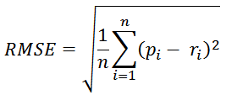
Accuracy measures
Datasets with items rated by users
MovieLens datasets 100K-10M ratings
Netflix 100M ratings
Historic user ratings constitute ground truth
Metrics measure error rate
Mean Absolute Error (MAE) computes the deviation between predicted ratings and actual ratings
Root Mean Square Error (RMSE) is similar to MAE, but places more emphasis on larger deviation

Slide 43
Content-based recommendation
Collaborative filtering does NOT require any information about the items,
However, it might be reasonable to exploit such information
E.g. recommend fantasy novels to people who liked fantasy novels in the past
What do we need:
Some information about the available items such as the genre ("content")
Some sort of user profile describing what the user likes (the preferences)
The task:
Learn user preferences
Locate/recommend items that are "similar" to the user preferences

Slide 44
Paradigms of recommender systems
Content-based: "Show me more of the same what I've liked"

Slide 45
What is the "content"?
The genre is actually not part of the content of a book
Most CB-recommendation methods originate from Information Retrieval (IR) field:
The item descriptions are usually automatically extracted (important words)
Goal is to find and rank interesting text documents (news articles, web pages)
Here:
Classical IR-based methods based on keywords
No expert recommendation knowledge involved
User profile (preferences) are rather learned than explicitly elicited

Slide 46
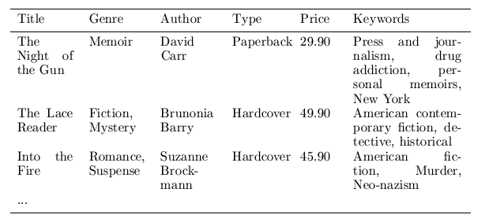
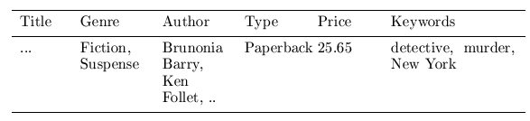

Content representation and item similarities
Simple approach
Compute the similarity of an unseen item with the user profile based on the keyword overlap (e.g. using the Dice coefficient)
sim(b_{i}, b_{j}) = $\frac{2 ∗|keywords\left(bi\right)∩keywords\left(bj\right)|}{\left|keywords\left(bi\right)\right|+|keywords\left(bj\right)|}$
Notes:
Intersection

Slide 47
Term-Frequency - Inverse Document Frequency (TF-IDF)
Simple keyword representation has its problems
In particular when automatically extracted because
Not every word has similar importance
Longer documents have a higher chance to have an overlap with the user profile
Standard measure: TF-IDF
Encodes text documents as weighted term vector
TF: Measures, how often a term appears (density in a document)
Assuming that important terms appear more often
Normalization has to be done in order to take document length into account
IDF: Aims to reduce the weight of terms that appear in all documents

Slide 48
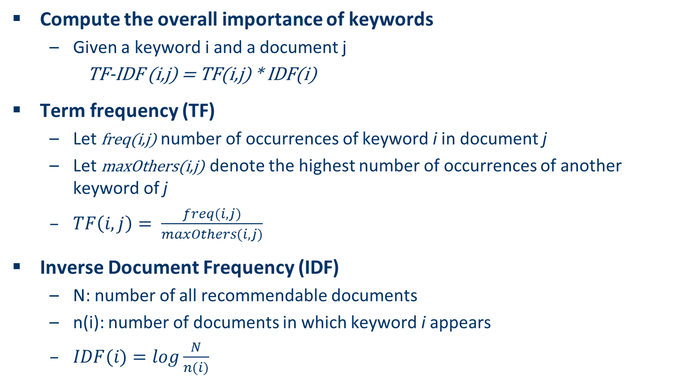
TF-IDF
Compute the overall importance of keywords
Given a keyword i and a document j
TF-IDF (i,j) = TF(i,j) * IDF(i)
Term frequency (TF)
Let freq(i,j) number of occurrences of keyword i in document j
Let maxOthers(i,j) denote the highest number of occurrences of another keyword of j
$TF\left(i,j\right)= \frac{freq(i,j)}{maxOthers(i,j)}$
Inverse Document Frequency (IDF)
N: number of all recommendable documents
n(i): number of documents in which keyword i appears
$IDF(i)=log\frac{N}{n(i)}$

Slide 49
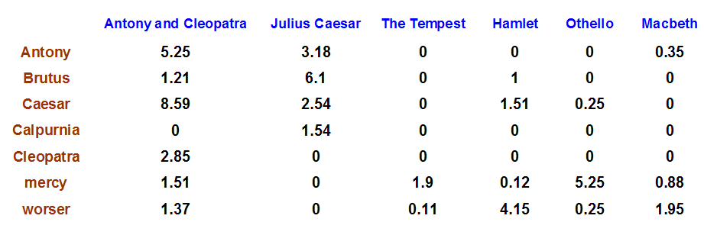
Example TF-IDF representation
Figure taken from http://informationretrieval.org

Slide 50
More on the vector space model
Vectors are usually long and sparse
Improvements
Remove stop words ("a", "the", ..)
Use stemming
Size cut-offs (only use top n most representative words, e.g. around 100)
Use additional knowledge, use more elaborate methods for feature selection
Detection of phrases as terms (such as United Nations)
Limitations
Semantic meaning remains unknown
Example: usage of a word in a negative context
"there is nothing on the menu that a vegetarian would like.."
Usual similarity metric to compare vectors: Cosine similarity (angle)

Slide 51
Recommending items
Simple method: nearest neighbors
Given a set of documents D already rated by the user (like/dislike)
Find the n nearest neighbors of a not-yet-seen item i in D
Take these ratings to predict a rating/vote for i
(Variations: neighborhood size, lower/upper similarity thresholds)
Query-based retrieval: Rocchio's method
The SMART System: Users are allowed to rate (relevant/irrelevant) retrieved documents (feedback)
The system then learns a prototype of relevant/irrelevant documents
Queries are then automatically extended with additional terms/weight of relevant documents

Slide 52
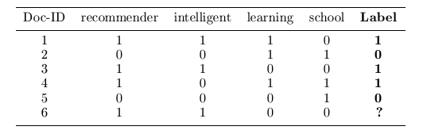
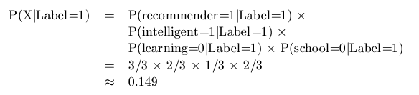
Probabilistic methods
Recommendation as classical text classification problem
Long history of using probabilistic methods
Simple approach:
2 classes: like/dislike
Simple Boolean document representation
Calculate probability that document is liked/disliked based on Bayes theorem
Remember:
P(Label=1|X)= k*P(X|Label=1) * P(Label=1)

Slide 53
Limitations of content-based recommendation methods
Keywords alone may not be sufficient to judge quality/relevance of a document or web page
Up-to-dateness, usability, aesthetics, writing style
Content may also be limited / too short
Content may not be automatically extractable (multimedia)
Ramp-up phase required
Some training data is still required
Web 2.0: Use other sources to learn the user preferences
Overspecialization
Algorithms tend to propose "more of the same"
E.g. too similar news items

Slide 54

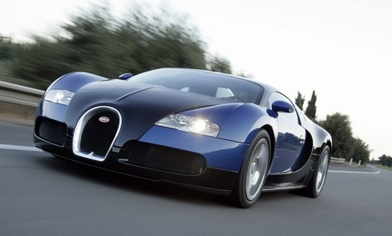
Why do we need knowledge-based recommendation?
Products with low number of available ratings
Time span plays an important role
Five-year-old ratings for computers
User lifestyle or family situation changes
Customers want to define their requirements explicitly
“The color of the car should be black"

Slide 55
Knowledge-Based Recommendation II
Different views on “knowledge”
Similarity functions
Determine matching degree between query and item (case-based RS)
Utility-based RS
E.g. MAUT – Multi-attribute utility theory
Logic-based knowledge descriptions (from domain expert)
E.g. Hard and soft constraints

Slide 56
Constraint-based recommendation I
A knowledge-based RS formulated as constraint satisfaction problem
Def.
X_{I}, X_{U}: Variables describing items and user model with domain D (e.g. lower focal length, purpose)
KB: Knowledge base comprising constraints and domain restrictions (e.g. IF purpose=“on travel” THEN lower focal length < 28mm)
SRS: Specific requirements of a user (e.g. purpose = “on travel”)
I: Product catalog (e.g. (id=1 ˄ lfl = 28mm) ˅ (id=2 ˄ lfl= 35mm) ˅ …)
Solution: Assignment tuple assigning values to all variables X_{I}
is satisfiable.

Slide 57
Item ranking
Multi-Attribute Utility Theory (MAUT)
Each item is evaluated according to a predefined set of dimensions that provide an aggregated view on the basic item properties
E.g. quality and economy are dimensions in the domain of digital cameras
id | value | quality | economy
price | ≤250 >250 | 5 10 | 10 5
mpix | ≤8 >8 | 4 10 | 10 6
opt-zoom | ≤9 >9 | 6 10 | 9 6
... | ... | ... | ...

Slide 58
Example: find minimal relaxations (minimal diagnoses)
Knowledge Base:
Product catalogue:
 | LHS | RHS
C1 | TRUE | Brand = Brand pref.
C2 | Motives = Landscape | Low. foc. Length =< 28
C3 | TRUE | Price =< Max. cost
Powershot XY
Brand | Canon
Lower focal length | 35
Upper focal length | 140
Price | 420 EUR
Current user:
 | User model (SRS)
R1 | Motives | Landscape
R2 | Brand preference | Canon
R3 | Max. cost | 350 EUR
Lumix
Brand | Panasonic
Lower focal length | 28
Upper focal length | 112
Price | 319 EUR
CS1
CS2
Diagnoses:

Slide 59
Ask user
Computation of minimal revisions of requirements
Do you want to relax your brand preference?
Accept Panasonic instead of Canon brand
Or is photographing landscapes with a wide-angle lens and maximum cost less important?
Lower focal length > 28mm and Price > 350 EUR
Optionally guided by some predefined weights or past community behavior
Be aware of possible revisions (e.g. age, family status, …)

Slide 60
Hybrid recommender systems
All three base techniques are naturally incorporated by a good sales assistance (at different stages of the sales act) but have their shortcomings
Idea of crossing two (or more) species/implementations
hybrida [lat.]: denotes an object made by combining two different elements
Avoid some of the shortcomings
Reach desirable properties not present in individual approaches
Different hybridization designs
Monolithic exploiting different features
Parallel use of several systems
Pipelined invocation of different systems

Slide 61
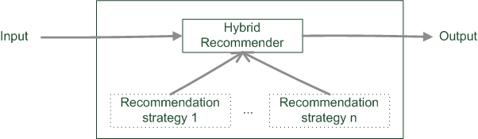
Monolithic hybridization design
Only a single recommendation component
Hybridization is "virtual" in the sense that
Features/knowledge sources of different paradigms are combined

Slide 62
Monolithic hybridization designs: Feature combination
"Hybrid" user features:
Social features: Movies liked by user
Content features: Comedies liked by user, dramas liked by user
Hybrid features: users who like many movies that are comedies, …
“the common knowledge engineering effort that involves inventing good features to enable successful learning” [BHC98]

Slide 63
Monolithic hybridization designs: Feature augmentation
Content-boosted collaborative filtering [MMN02]
Based on content features additional ratings are created
E.g. Alice likes Items 1 and 3 (unary ratings)
Item7 is similar to 1 and 3 by a degree of 0,75
Thus Alice likes Item7 by 0,75
Item matrices become less sparse
Recommendation of research papers [TMA+04]
Citations interpreted as collaborative recommendations
Integrated in content-based recommendation method

Slide 64
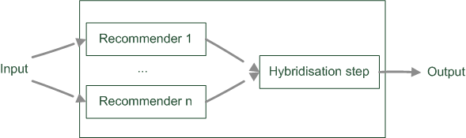
Parallelized hybridization design
Output of several existing implementations combined
Least invasive design
Weighting or voting scheme applied
Weights can be learned dynamically

Slide 65
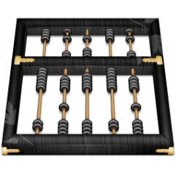
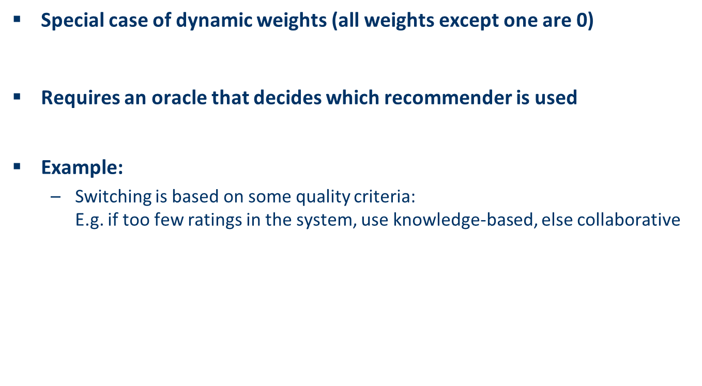
Parallelized hybridization design: Switching
Special case of dynamic weights (all weights except one are 0)
Requires an oracle that decides which recommender is used
Example:
Switching is based on some quality criteria: E.g. if too few ratings in the system, use knowledge-based, else collaborative

Slide 66
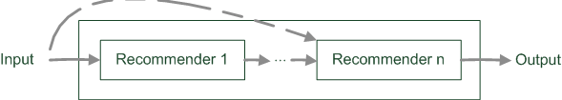
Pipelined hybridization designs
One recommender system pre-processes some input for the subsequent one
Cascade
Meta-level
Refinement of recommendation lists (cascade)
Learning of model (e.g. collaborative knowledge-based meta-level)

